Slide 1
Goldwater and Fulbright
Spring Fellowships Workshop
4/4/13
DeDomnici

Slide 2
Prestigious Grants and Fellowships
Prestigious grants and fellowships include a wide range of external financial awards for outstanding students.
Awards may be used for tuition, study abroad, graduate school, independent research, public service, internships, or teaching experiences in the U.S. or abroad.

Slide 3
Examples
Fulbright Awards
Each year 1700 US students receive awards for study or research abroad.
Goldwater
Sophomores and Juniors in the Sciences, Math and Engineering receive $7500 per academic year

Slide 4
Fulbright
“Public Diplomacy”
Any academic discipline; language study highly advantageous.
Juniors may apply – Bachelors degree must be completed before award may be issued.
Alumni are eligible to apply as well.
October 1st UNH internal deadline (tentative)– for all materials

Slide 5
Fulbright (continued)
The Study/Research (“Fulgrant”) award is a more involved process involving a self-designed research project and outreach to a potential adviser/mentor in the host country.
Art-based proposals also have portfolio requirements, and these are evaluated first.
The English Teaching Assistant program application is more straightforward; K-12 or university placement as a language instructor

Slide 6
Fulbright: Helpful Links
http://www.temple.edu/studyabroad/students/fulbright/sample_essays.htm
http://us.fulbrightonline.org/tutorials
http://www.isp.msu.edu/funding/fulbright_proposals.htm

Slide 7
Goldwater
The most prestigious undergraduate award in the STEM areas (excluding clinical medicine).
Available to natural science, math, and engineering majors.
Open to sophomores or juniors, 3.0 minimum GPA
Must be a United States citizen, a permanent resident seeking citizenship
http://www.act.org/goldwater/index.html

Slide 8
Goldwater Essay
Should discuss a significant issue or problem in your field of study, and how your research could address that problem.
Proposal will be reviewed by specialists in your field.

Slide 9
Timeline
6 months – Identify deadlines. Make strategic course selections and/or apply for relevant internships. Locate application materials, identify potential recommenders.
3 months – Work on resume, ensuring it is current. Touch base with recommenders. Consult with UNH fellowship adviser. Start drafting materials. Create checklist of needed materials.

Slide 10
Timeline
1 month – Solicit all recommendations being sure to provide all necessary materials. Revise and proofread drafts of all application materials in consultation with Fellowships Adviser. Use checklist to assemble application package and apply.

Slide 11
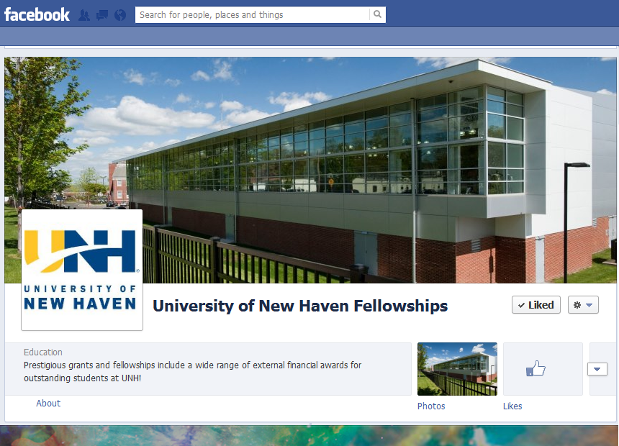
www.facebook.com/UNHfellowships

Slide 12
http://www.newhaven.edu/fellowships

