Slide 1
NSF Proposal & Award Policy Update
CLASP Annual Meeting November 2018

Slide 2
SPEAKER
Anne Doyle
Senior Policy Analyst, Policy Office, Division of Institution & Award Support; Office of Budget, Finance & Award Management
▪ Phone: (703) 292-4806
E-Mail: adoyle@nsf.gov and policy@nsf.gov

Slide 3
TOPICS
NSF Personnel Updates
PAPPG Proposed Significant Changes
NSF Harassment Term & Condition Implementation
Changes in Objective or Scope - Reminders
Proposal Submission in Research.gov
Account Management Updates
Update of the NSF Award System
Public Access Enhancement
Responsible and Ethical Conduct of Research
NSF Big Ideas Solicitations
Upcoming Outreach Opportunities

Slide 4
HOW NSF IS ORGANIZED
4
Office of Diversity & Inclusion
National Science Board (NSB)
Director Deputy Director
Office of the General Counsel
Office of Integrative Activities
Office of the Inspector General (OIG)
Office of International Science & Engineering
Office of Legislative & Public Affairs
Computer & Information Science & Engineering (CISE)
Mathematical
& Physical Sciences (MPS)
Biological Sciences (BIO)
Engineering (ENG)
Geosciences (GEO)
Social, Behavioral
& Economic Sciences (SBE)
Education
& Human Resources (EHR)
Budget, Finance
& Award Management (BFA)
Information
& Resource Management (IRM)

Slide 5
5
UPCOMING PAPPG IMPLEMENTATION SCHEDULE
November 2, 2018 – Released to the community
• January 28, 2019 – PAPPG becomes effective

Slide 6
PAPPG SIGNIFICANT CHANGES
Use of Research.gov for proposal submission: Policy versus on-screen instructions
Expanded use of Dear Colleague Letters
International Branch Campuses of US Institutions of Higher Education and Foreign Organizations
Proposal font, spacing and margin requirements
Additional highlighting of NSF’s research misconduct policy
Synergistic Activities clarification

Slide 7
PAPPG SIGNIFICANT CHANGES
Participant Support enhancements
RAPID, EAGER and RAISE
Resubmission
Harassment policy – Implementation of Important Notice 144
Final Project Report and Project Outcomes Report
Definition (new) for Unexpended Balance
Micropurchase threshold increase to $10K
Intellectual Property

Slide 8
8
IMPORTANT NOTICE 144 ON HARASSMENT
National Science Foundation (NSF) will not tolerate sexual harassment, or any kind of harassment, within the agency, at grantee organizations, field sites, or anywhere NSF- funded science and education are conducted.
NSF is committed to promoting safe, productive research and education environments for current and future scientists and engineers.
The PI and co-PI and all grant personnel must comport themselves in a responsible and accountable manner, including during the performance of award activities conducted outside the organization, such as at field sites or facilities, or during conferences and workshops.

Slide 9
SEXUAL HARASSMENT TERM AND CONDITION STATUS
NSF received a significant number of comments – from institutions of higher education, scientific societies, for- profit organizations, faculty, students, etc. - during the 60 day comment period, which closed on May 4, 2018
NSF carefully considered each comment in development of a revised term and condition
NSF hosted a Roundtable on Sexual Harassment with representatives from professional societies (including representatives from COGR, AAU, APLU) on July 24th

Slide 10
SEXUAL HARASSMENT TERM AND CONDITION STATUS
New term and condition announced on September 21st.
Applies to all new awards and funding amendments to existing awards issued on or after October 22, 2018.
Requires the awardee to notify NSF if the PI or co-PI is placed on administrative leave or if the awardee has imposed any administrative action on the PI or any co-PI relating to any finding/determination or an investigation of an alleged violation of awardee policies or codes of conduct, statutes, regulations, or executive orders relating to sexual harassment, other forms of harassment, or sexual assault.

Slide 11
CHANGES TO THE PAPPG TO ADDRESS HARASSMENT
New coverage has been added to the conference proposal section.
•
Two new notification requirements have been added to the listing of required grantee notifications to NSF in accordance with the new term and condition.
Change in PI coverage now has Changes in PI at the Initiation of the Grantee Organization, and Changes in PI at the Initiation of NSF.
Non-Discrimination Statutes and Regulations coverage has been expanded to include a new paragraph that addresses the “NSF Policy on Sexual and Other Forms of Harassment”, as well as a reference to the new grant condition that implements the harassment policy.

Slide 12
WHAT OTHER STEPS HAVE WE TAKEN?
Enhanced Web Resources
NSF recently launched a dedicated web portal [www.nsf.gov/harassment] to consolidate policies and procedures, promising practices, and frequently asked questions relating to sexual and other forms of harassment
This will be the same website where notifications will be submitted
Questions should be directed to the Office of Diversity & Inclusion (ODI) at programcomplaints@nsf.gov

Slide 13
CHANGES IN OBJECTIVE OR SCOPE - REMINDERS
The objectives or scope of a project may not be changed without prior NSF approval.
NSF does not define what constitutes a change in objectives or scope.
Requests must be submitted by the AOR via Research.gov
Prior NSF approval also is required for postaward changes to the Facilities, Equipment & Other Resources section of the approved proposal that constitute changes in objectives or scope.
Post-award rebudgeting of person months devoted to the project may require NSF prior approval if the change would cause the objectives or scope of the project to change.
See PAPPG, Chapter VII.B.1.a

Slide 14
PROPOSAL SUBMISSION IN RESEARCH.GOV
Modernizes the applications supporting proposal submission and improves the user experience via the development of a new application
Reduces the administrative burden to the research community and NSF staff associated with preparation, submission, and management of proposals
Increases efficiencies in proposal preparation, submission, and management
Improves data quality and captures proposal content in a way that
supports data analytics
Improves availability, security, and flexibility of proposal preparation and submission IT systems

Slide 15
WHY ARE WE MODERNIZING NSF’S PROPOSAL SUBMISSION CAPABILITY?
The Problem Statement Suggestions for Potential Solutions
In June 2015, NSF surveyed PIs and SPOs about the proposal submission capabilities
SPO-80%
available in FastLane and used this feedback to target proposal submission
PI - 75%
modernization improvements
40% 60%
33%
PI - 25%
SPO
- 10%
55%
55%
Ease of Use
Webpage Layout not Intuitive
Administrative Burden
Data Pre- population
Just-in-Time Proposal Submission
Revision of NSF Solicitations
Expanded Compliance Checking
*Results based on 16,736 responses from the June 2015 survey sent to 116,638 members of the research community

Slide 16
PROPOSAL SUBMISSION IN RESEARCH.GOV
Initial release allows submission of Full, Research non-collaborative proposals, enabling the following features:
AOR Proposal Submission
Proposal File Update & Budget Revision
Future releases will enable other proposal types and features

Slide 17
RESEARCH.GOV: RECENT ENHANCEMENTS
Additional flexibilities for PDF uploads
Support for PDFs generated from LaTeX source documents
Compliance checks for fonts and font sizes
Arial (not Arial Narrow), Courier New, Palatino, Palatino Linotype, or Helvetica at a font size of 10 points or larger.
Times New Roman at a font size of 10 points or larger
Computer Modern family of fonts at a font size of 10 points or larger.
Other fonts not specifies above such as Cambria Math, may be used for mathematical formulas, equations, or when inserting Greek letters or special characters.
Sign up for enhancements and events. Send an e-mail to: system_updates-subscribe-request@listserv.nsf.gov

Slide 18
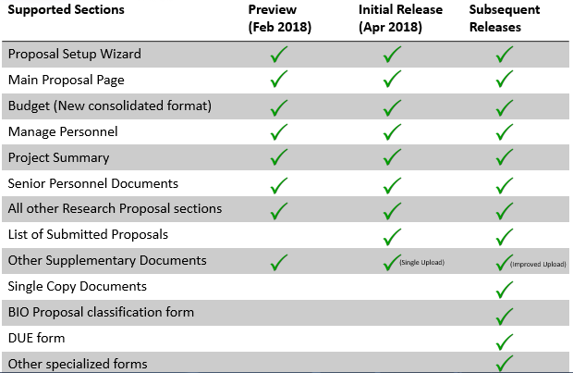
PROPOSAL SUBMISSION IN RESEARCH.GOV

Slide 19
FUTURE ENHANCEMENTS
Withdraw/delete proposal
Collaborative proposals
Additional proposal types (e.g., EAGER, RAPID, etc.)
Additional submission types (e.g., Letters of Intent, ABR, Pre-proposal)
All proposal documents and forms (e.g., Substitute Negotiator, DUE Form)
Additional Single Copy Documents
Solicitation-specific proposal sections (e.g., BIO classification form and company commercialization history form for SBIR proposals)
Data pre-population (e.g., Current and Pending Support)
Unique FastLane modules (e.g., SBIR/STTR, GRFP)

Slide 20
ACCOUNT MANAGEMENT MODERNIZATION
NEW: Account Removal
Administrators can remove users from their organizations who have not migrated to the new account management system
Unmigrated users include those who have left the organization
Available as of October 22, 2018
Ongoing and Coming Soon
NSF is continuing to reconcile duplicate accounts
Contact the NSF Help Desk at 1-800-381-1532 or rgov@nsf.gov if you need to have your account fixed
If you have a pending deadline…CALL and tell us
This fall, NSF plans to start contacting users utilizing group email aliases as their primary email addresses
NSF is not supporting group email aliases as account recovery email addresses

Slide 21
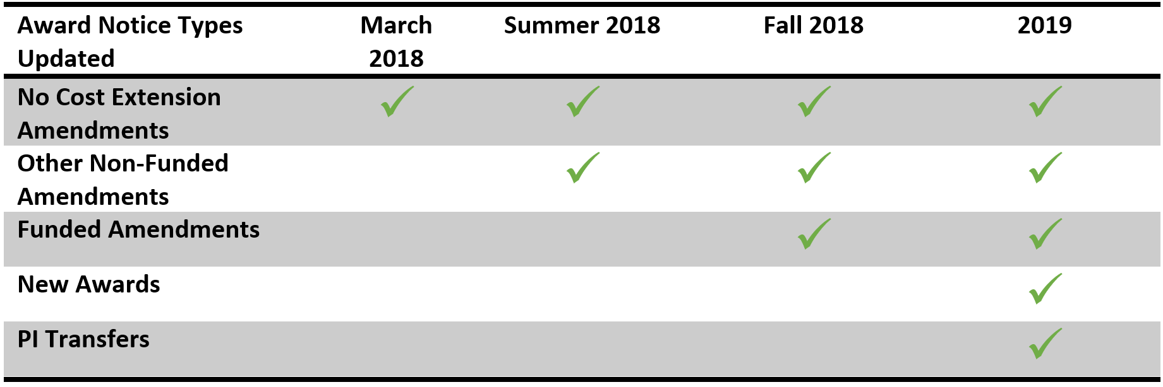
UPDATE OF THE NSF AWARD SYSTEM
NSF is modernizing and improving its Awards system used by the Division of Grants & Agreements (DGA) and the Division of Acquisition
& Cooperative Support (DACS)
Moving to a standardized, easy-to-use format for both grants and cooperative agreements
No changes are needed from awardees: both old and new documents will be in Fastlane as usual

Slide 22
NSF PUBLIC ACCESS
Background
NSF’s Public Access policy requires NSF-funded investigators to deposit peer- reviewed, published journal articles and juried conference papers in the NSF Public Access Repository (NSF-PAR)
Statistics
Over 5,300 publications have been deposited by PIs
Over 48,000 visitors accessed the NSF Public Access Repository
Over 38,000 records in the repository, updated daily by PI deposits and records pulled from CHORUS
Updates
Effective March 26, 2018, NSF authors who are jointly funded by the National Science Foundation (NSF) and the Department of Energy (DOE) can retrieve previously submitted final manuscripts from the DOE system and pull them into NSF-PAR to meet NSF’s Public Access requirement

Slide 23
NSF PUBLIC ACCESS (CONT’D)
Tips
PDF/A Conversions
▪
▪
Work with the publisher to obtain a PDF/A compliant file
Work with third party tools to convert documents (Adobe Acrobat, PDF Creator, DocuPub, GhostScript, etc.)
Final printed version or final peer-reviewed manuscript is acceptable for deposit
▪
Publishing dates – Sometimes when depositing by DOI, the wrong publication date is pulled
▪
Preferred before submission -Work with the publisher to correct, double check online publication date versus print date
Post Submission contact NSF Help Desk
▪
PIs can continue to add and deposit publications after an award is closed (regardless if the award is subject to the public access mandate)
Additional deposits will appear for the closed award in NSF.gov’s Award Search. Modifying the Project Outcome reports is not necessary
Upcoming Enhancements to Products in Project Reporting
Deposits for Interim project reports are carried over to the next annual or final report
Usability – Cumulative product view, view by reporting period
Usability – Consolidating navigation and reducing clicks

Slide 24
RESPONSIBLE AND ETHICAL CONDUCT OF RESEARCH
NSF expects adherence to high standards of responsible and ethical conduct in the science, technology, engineering and mathematics (STEM) research and education that NSF supports
All allegations of Research Misconduct should be reported promptly to the Office of the Inspector General (OIG)
NSF awardees are subject to the responsible conduct of research requirement of the America COMPETES Act of 2007 (Public Law 110-69)
NSF funds research and dissemination of findings on Cultivating Cultures for Ethical Science, Technology, Engineering, and Mathematics (STEM)

Slide 25
RESPONSIBLE AND ETHICAL CONDUCT OF RESEARCH (CONT’D)
Upon proposal submission, AORs certify that the organization has a plan to provide RCR training to students and postdocs supported by NSF (see PAPPG, Chapters II.C.1.d and IX.B)
NSF may review the plans upon request
The Online Ethics Center (www.onlineethics.org) provides RCR resources to assist organizations in developing their training plans
Each organization determines content, focus, and delivery method for training, tailored to specific needs
NSF recommends that the content address fabrication, falsification, and plagiarism, at a minimum

Slide 26
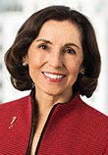
NSF’s 10 BIG IDEAS FOR FUTURE INVESTMENT
RESEARCH IDEAS
Work at the Human- Technology Frontier: Shaping the Future
Windows on the Universe: Multi- messenger
Quantum Leap: Leading the Next Quantum Revolution
Astrophysics
Harnessing Data for 21st Century Science and Engineering
“ … bold questions that will drive NSF's long-term research agenda -- questions that will ensure future generations continue to reap the benefits of fundamental S&E research. ”
Navigating the
New Arctic
Understanding the Rules of Life: Predicting Phenotype
PROCESS IDEAS
Mid-scale Research Infrastructure
NSF 2026
Growing Convergence Research at NSF
NSF INCLUDES:
Enhancing STEM through Diversity and Inclusion

Slide 27
UPCOMING BIG IDEAS SOLICITATIONS
NSF is planning to ramp up its investments in the Big Ideas in FY 2019 as specified in the FY 2019 Request
There will be a number of new program solicitations in FY 2019 for the Big Ideas
The appearance of the Big Ideas solicitations will be different than what you have seen in the past due to the convergent nature of these programs
Instead of designating specific directorates as NSF has traditionally done, each of these solicitations will have the name of the Big Idea in the header.
We anticipate that proposals will be submitted to one directorate/division, but the reviews will be handled by all of the participating directorates/offices.

Slide 28
NSF OUTREACH
NSF Grants Conference (November 8-9) in New Orleans
Plenary sessions will be webcast live and available on- demand
Sign up at https://nsfgrantsconferences.com/
PAPPG – Webcasts for the Research Community
November and January
NSF Grants Conference (May 20-21) in Los Angeles
Sign up to be notified of all policy-related events at:
https://nsfgrantsconferences.com/get-notified/

Slide 29
FOR MORE INFORMATION
29
Ask Early, Ask Often!
policy@nsf.gov

