Slide 1
SEARCHING
FOR AN
ON-CAMPUS JOB

Slide 2
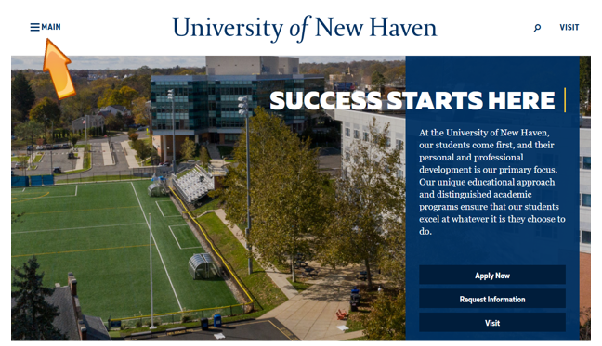
Select the Main Menu on the University webpage

Slide 3
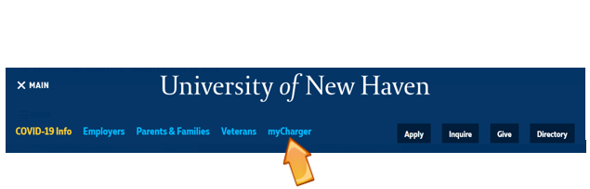
Click on myCharger

Slide 4
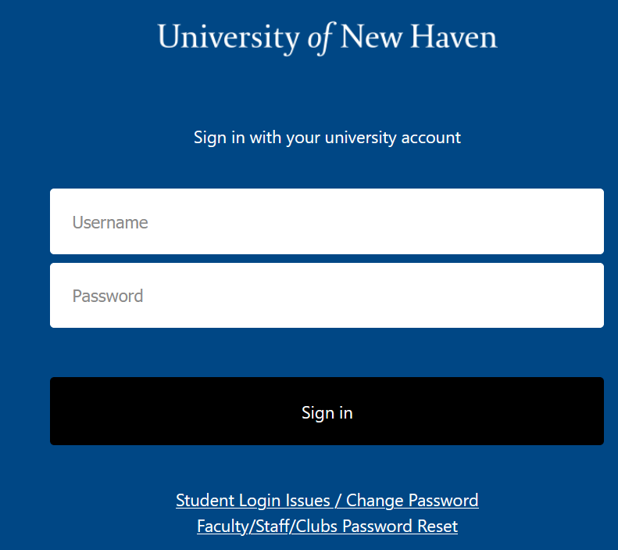
If needed, sign in using your University credentials

Slide 5
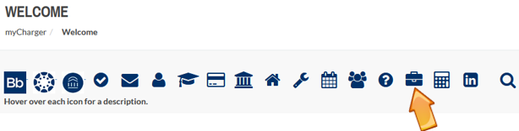
Click on the briefcase icon on the Welcome Page to enter the SEO Portal

Slide 6
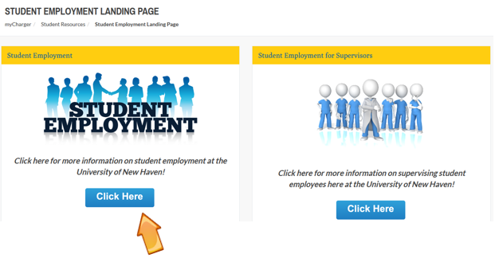

Slide 7
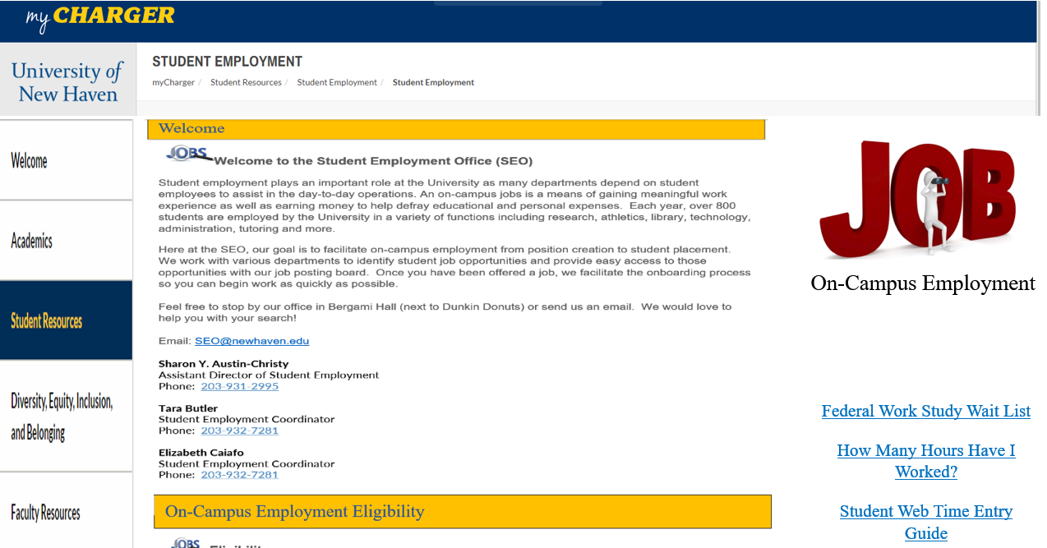
Click on On-Campus Employment Icon

Slide 8
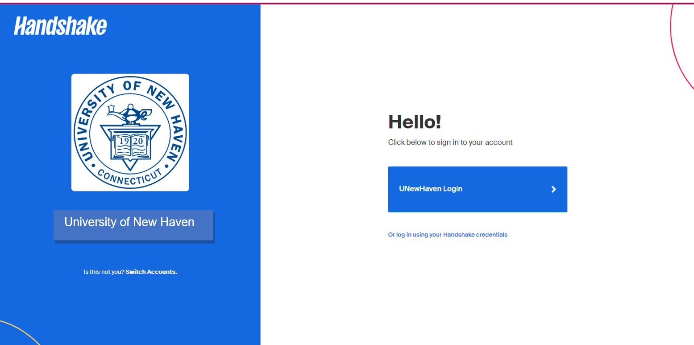
Click on UNewHaven Login

Slide 9
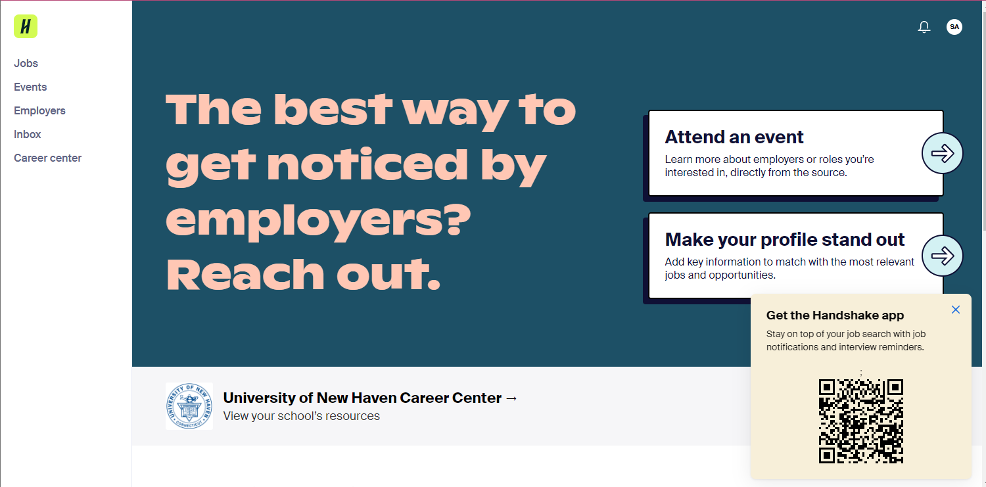
Click on Jobs

Slide 10
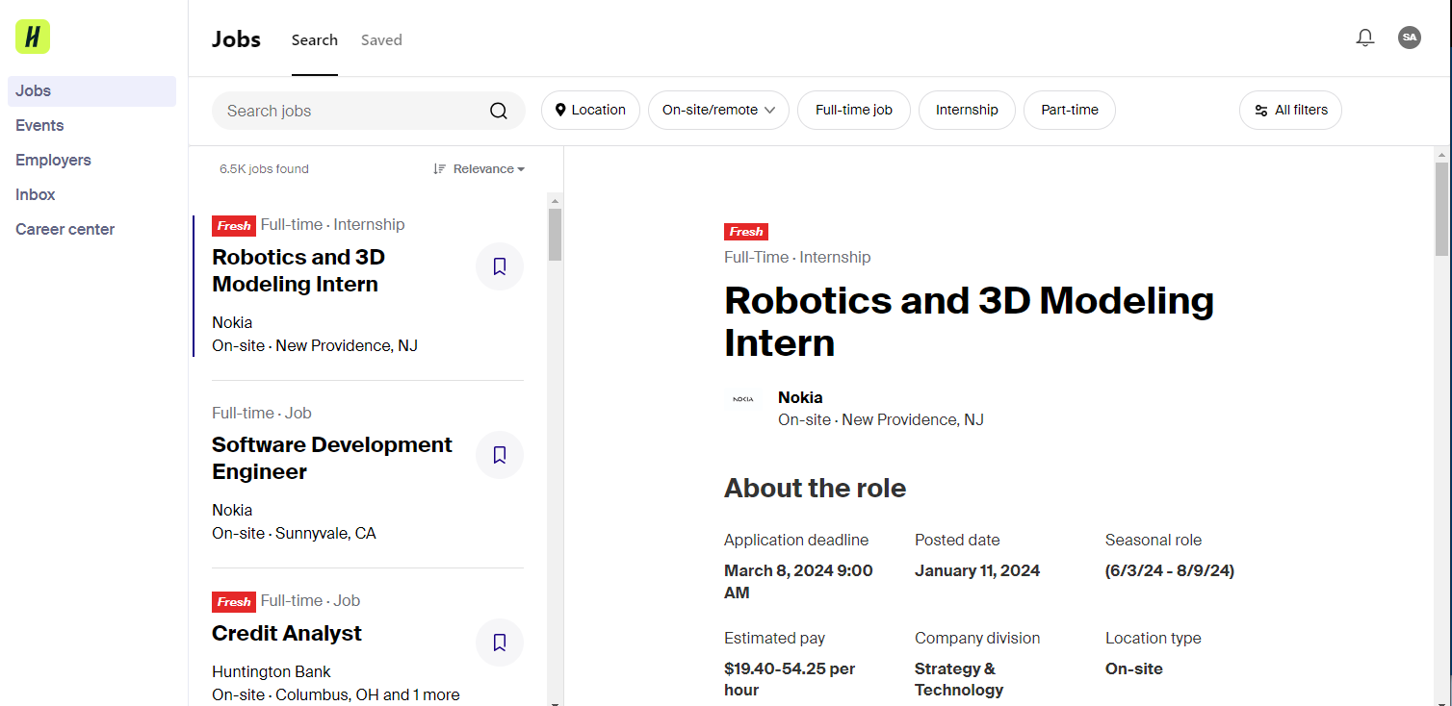
Click on All Filters

Slide 11
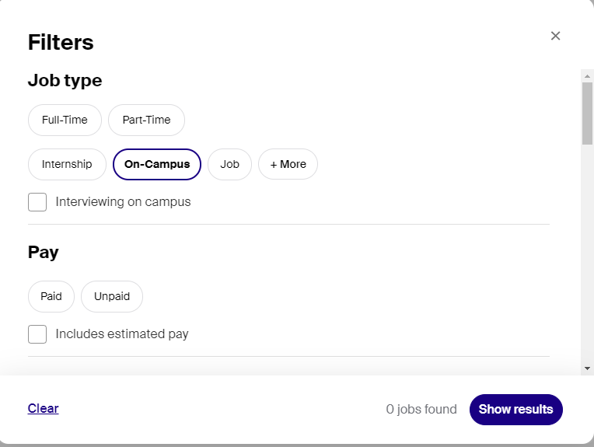
To see Non-Federal Work Study (NFWS) job openings:

Slide 12
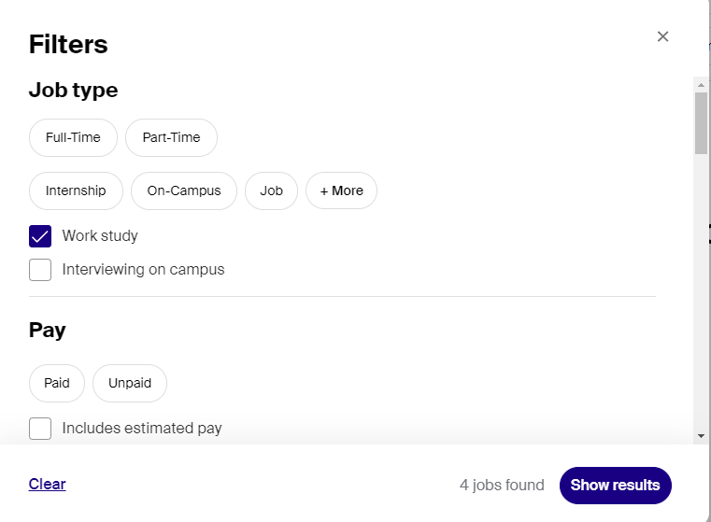
To see Federal Work Study (FWS) job openings:
NOTE:
The Work Study option will only be available to students who were awarded FWS and have accepted their FWS award.

Slide 13
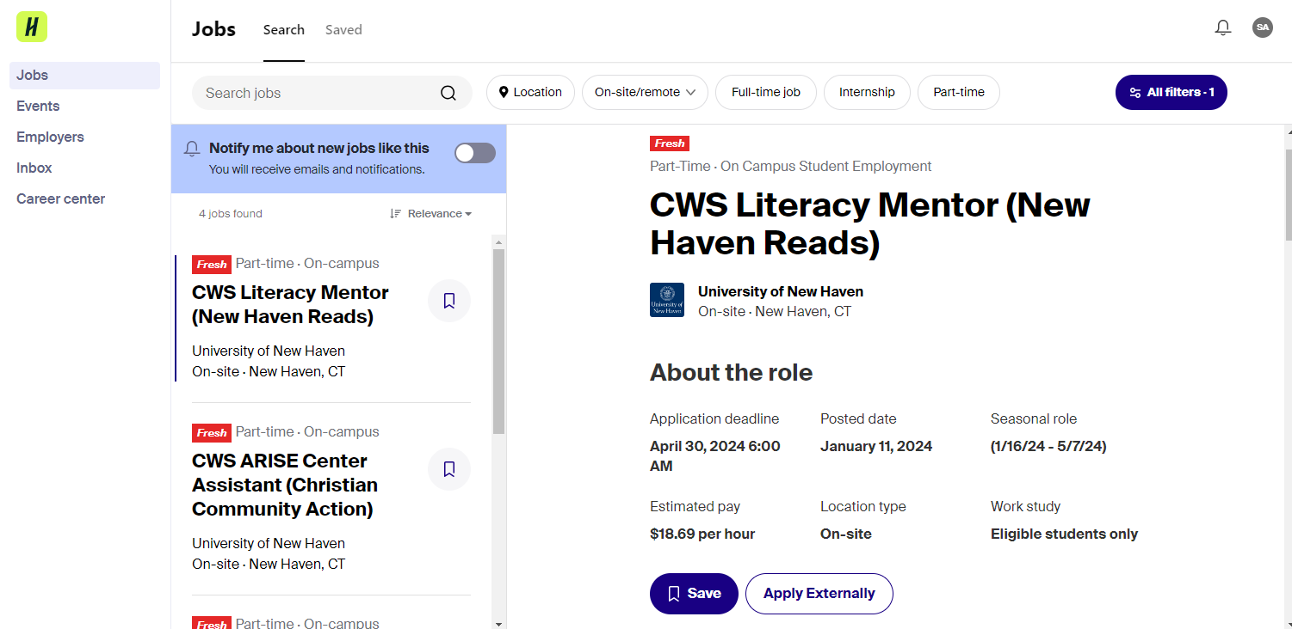
Click on the job to see the job details on the right. If interested, apply using the Apply button.

Slide 14
Feel free to contact the Student Employment Office (SEO) with any questions regarding your job search:
seo@newhaven.edu
Contact the Career Development Center (CDC) if you are having difficulty logging in to view on-campus jobs:
careerdevelopmentcenter@newhaven.edu

